Slide 1


New Negotiation Power
Sami Miettinen
Co-author, New Negotiation Power
www.neuvottelija.com
You get what you negotiate
English framework · © 2026
Notes:
Opening: negotiation is a capability system, not a bag of tricks. State the promise: participants leave with a repeatable preparation method. Source: Miettinen & Torkki, Uusi neuvotteluvalta, WSOY 2019.

Slide 2

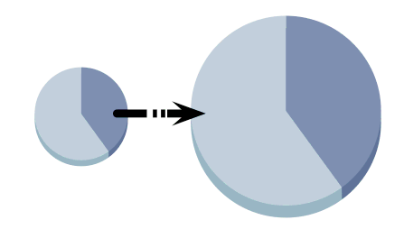
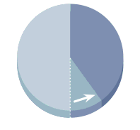
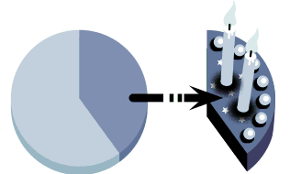
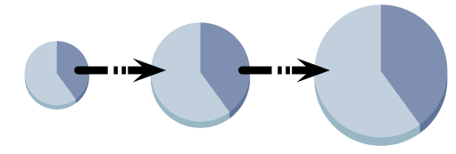
Four dimensions make one negotiation system
1 – Power (Valta)
2 – Analytics (Analyyttisyys)
3 – Interaction (Sosiaalisuus)
4 – Principles (Periaatteellisuus)
Notes:
Power claims and protects value. Analytics creates and selects value. Interaction makes value understandable and acceptable. Principles sustain trust and outcomes over time. Use the memory aid: muscles, brain, heart, soul.

Slide 3
Each dimension answers a different failure mode
1 – Power (Valta)
2 – Analytics (Analyyttisyys)
Status
Ranges
Game
Theory
Price
Indirect
Power
Direct Power
Time
Management
Artist and
Engineer
3 – Interaction (Sosiaalisuus)
4 – Principles (Periaatteellisuus)
Reputation
Negotiation
Team
Algorithms
Signalling
Trust
Account
Ethics
Archetypes
Notes:
Ask the room for one recent failure. Classify it: no leverage, no useful option, no human acceptance, or no long-term governance. Most failures touch more than one dimension.

Slide 4






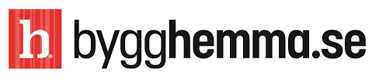

Choose win, win-win—or no deal
Do not drift into compromise because no one prepared an alternative
High
Competition
Win-Win
15 corporate marriages
Compromise
Focus on own needs
No deal
Giving up
Good negotiator
Amateur
Good negotiator
Focus on the negotiation party needs
High
Notes:
A good negotiator can compete, create joint gain, or leave. Compromise is a tool, not the default. The right no deal can protect value and reputation.

Slide 5
Prepare five result families before the meeting
Compromise
Compromise: 5%
Own Benefit: 20%
No deal
New Partner: 5%
Walk Away: 20%
Partner Benefit: 20%
Win-Win
Synergistic Solution: 30%
Notes:
The percentages are a preparation discipline. Force the team to imagine own benefit, partner benefit, synergy, walk-away/new partner, and compromise before social pressure narrows the field.

Slide 6

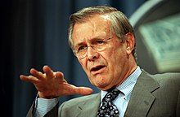

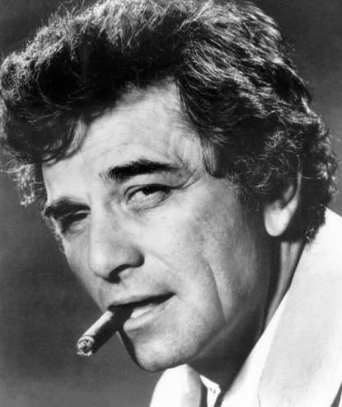
Separate signals from what you actually know
Map knowns, unknowns, hidden cards and testable questions
“Reports that say that something hasn't happened are always interesting to me, because as we know, there are known knowns; there are things we know we know. We also know there are known unknowns; that is to say we know there are some things we do not know. But there are also unknown unknowns — the ones we don't know we don't know. And if one looks throughout the history of our country and other free countries, it is the latter category that tend to be the difficult one” – Donald Rumsfeld
We seek a partner
Growth,
Disruption,
Profitability
We partner
for long term
Björn Wahlroos approach:
We will sell Sampo Bank for over €3.5 billion!
We are being
disrupted
You are our
best option
How to check the
hidden cards? Ask!
We have no clue
of our KPIs
Notes:
Distinguish evidence from inference. Open cards can build trust; hidden cards protect legitimate position. Convert every important assumption into a respectful test question.

Slide 7
Create optionality before you need it
Run a preferred-partner track and a credible Plan B in parallel
Timetable
NOW
Month | November |  |  |  | December |  |  |  | January
Week | 45 | 46 | 47 | 48 | 49 | 50 | 51 | 52 | 1 | 2 | 3 | 4
Preferred Partner track:
Timetable if the preferred partner continues to add value in an environment of trust
Continuation of on-premises development
KPI work stream
Lean development phase
Kick-off
Joint operational development
Competence scoping
Invoicing phase
Agreement signed
Review and next steps
Go / no-go decision from decision makers
Plan B:
Preliminary timetable with new partners brought to the table
Meeting new partner 1
KPI work stream
Scoping meetings
LOI terms negotiated
Kick-off
Lean development phase
Meeting new partner 2
LOI signed
Joint operational development
Indicative offer(s)
Agreement distributed
Invoicing phase
Go / no-go decision– Plan B initiated
Agreement signed
Review and next steps
Notes:
Optionality creates liquidity and changes power before anyone threatens. Plan B must be real enough to execute; a bluff is not a BATNA.

Slide 8
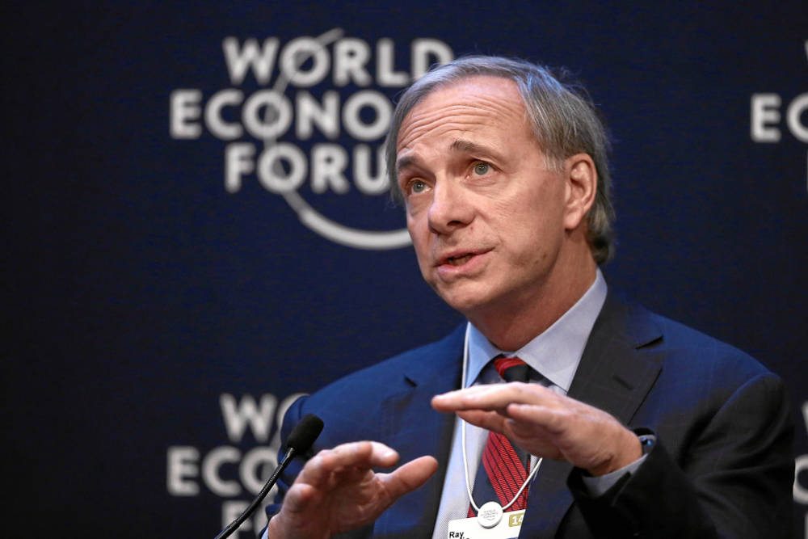

Turn values into repeatable Principles
PRINCIPLES
Problem mapping: We have burnouts and the project execution and customer satisfaction is low because of them
“Principles are what allow you to live a life consistent with those values. Principles connect your values to your actions.”
– Ray Dalio
1
2
Problem analysis: Why and who gets burnouts, how the organisation reacts to them.
3
Algorithm building:
A1) IF burnout indicator score > threshold value, THEN execute script preventive measures
A2) IF burnout work status = burned, THEN
execute script burnout HR recovery
4
Principle implementation:
A1 and A2 execute, debug, A/B test, KPI track
Notes:
Principles translate values into action. Map a recurring problem, analyse causes, write an if/then operating rule, then implement and improve it. Ethics defines the boundary even when breach would pay.

Slide 9

Move cognition into Dialogue Planning
Dialogue Planning Phase
Negotiation Phase
Trust
Principles (Periaatteellisuus)
Improved
Trust Carry
Forward
Agreement
Interaction (Sosiaalisuus)
Power (Valta)
Analytics (Analyyttisyys)
Selection
of criteria
Building the
relationship
Package
deals
Reputation &
References
Mapping the
options
Trustworthy
Meeting
Impression
Data
sources
80%
20%
Time
Mapping the
needs
Relevant
Agenda
Critical moments
Q&A Call
Pre-meeting
resistance
Distrust
Notes:
The 80/20 rule is directional: approximately 80 percent of cognitive work belongs in Dialogue Planning, 20 percent in the live phase. The purpose is to think before pressure peaks.

Slide 10
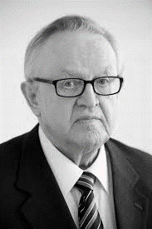


Give every negotiator a defined team role
PRINCIPLES
Alpha: Authority and decisions
Beta: Dialogue and options
Gamma: Notes and signals
Q: Why you are so serious?
A: Somebody has to be
Match mandate
Chair ↔ Chair
CEO · CFO · Legal ↔ peers
Escalation:
I want you to take this offer to your board
Charm offensive
Good cop-Bad cop
Notes:
Alpha owns authority and boundaries, Beta maintains dialogue and explores options, Gamma observes and records. Agree roles and a private back channel before the meeting.

Slide 11
The trust account compounds across negotiations
PRINCIPLES
The first negotiation is an investment; reliable delivery carries value forward
Investment Phase
Continuous Relationship Phase
Cumulative negotiation benefit
The infinite game: New teams?
Second and third negotiations are much easier and benefits much higher
9
8
5
6
3
4
7
Catch the falls!
2
Time
1
First negotiation is a major effort e.g. an investment
Bubble size denotes negotiation effort i.e. investment
Notes:
Trust is accumulated relational capital. Delivery and fair problem-solving make deposits. Humiliation and surprise make withdrawals. A positive balance makes later negotiations faster and more resilient.

Slide 12
Prepare the moments that shape the room
Anchoring
First
Referenced
Not rounded
“€64 per hour, based on last year average for this service level for your competitors”
First Impressions
Physical
Happy Low Status
Pre-meeting work
References
Network Theory
LinkedIn>1000
Personal References
Critical nodes
Optionality
Trust
Notes:
Use this as the closing preparation check: first impression, precise referenced anchor, network/decision map, optionality, and trust effect. Add mandate, criteria and team roles in the discussion.

Slide 13
Practice. Debrief. Repeat.
Sami Miettinen
www.neuvottelija.com/negotiation/
Definitive English corpus and training
Ars · Imitatio · Exercitio
Framework: Miettinen & Torkki · © 2026
Notes:
Close with the learning loop: Ars is systematic knowledge and craft; Imitatio is observation of excellent negotiators; Exercitio is repeated practice and feedback. Ask each participant to name one dimension they will train next.

